Slide 1

SOFTWARE SECURITY
Pillars, Vulnerabilities, and Best Practices
Dr. Mohammed Tawfik

Slide 2


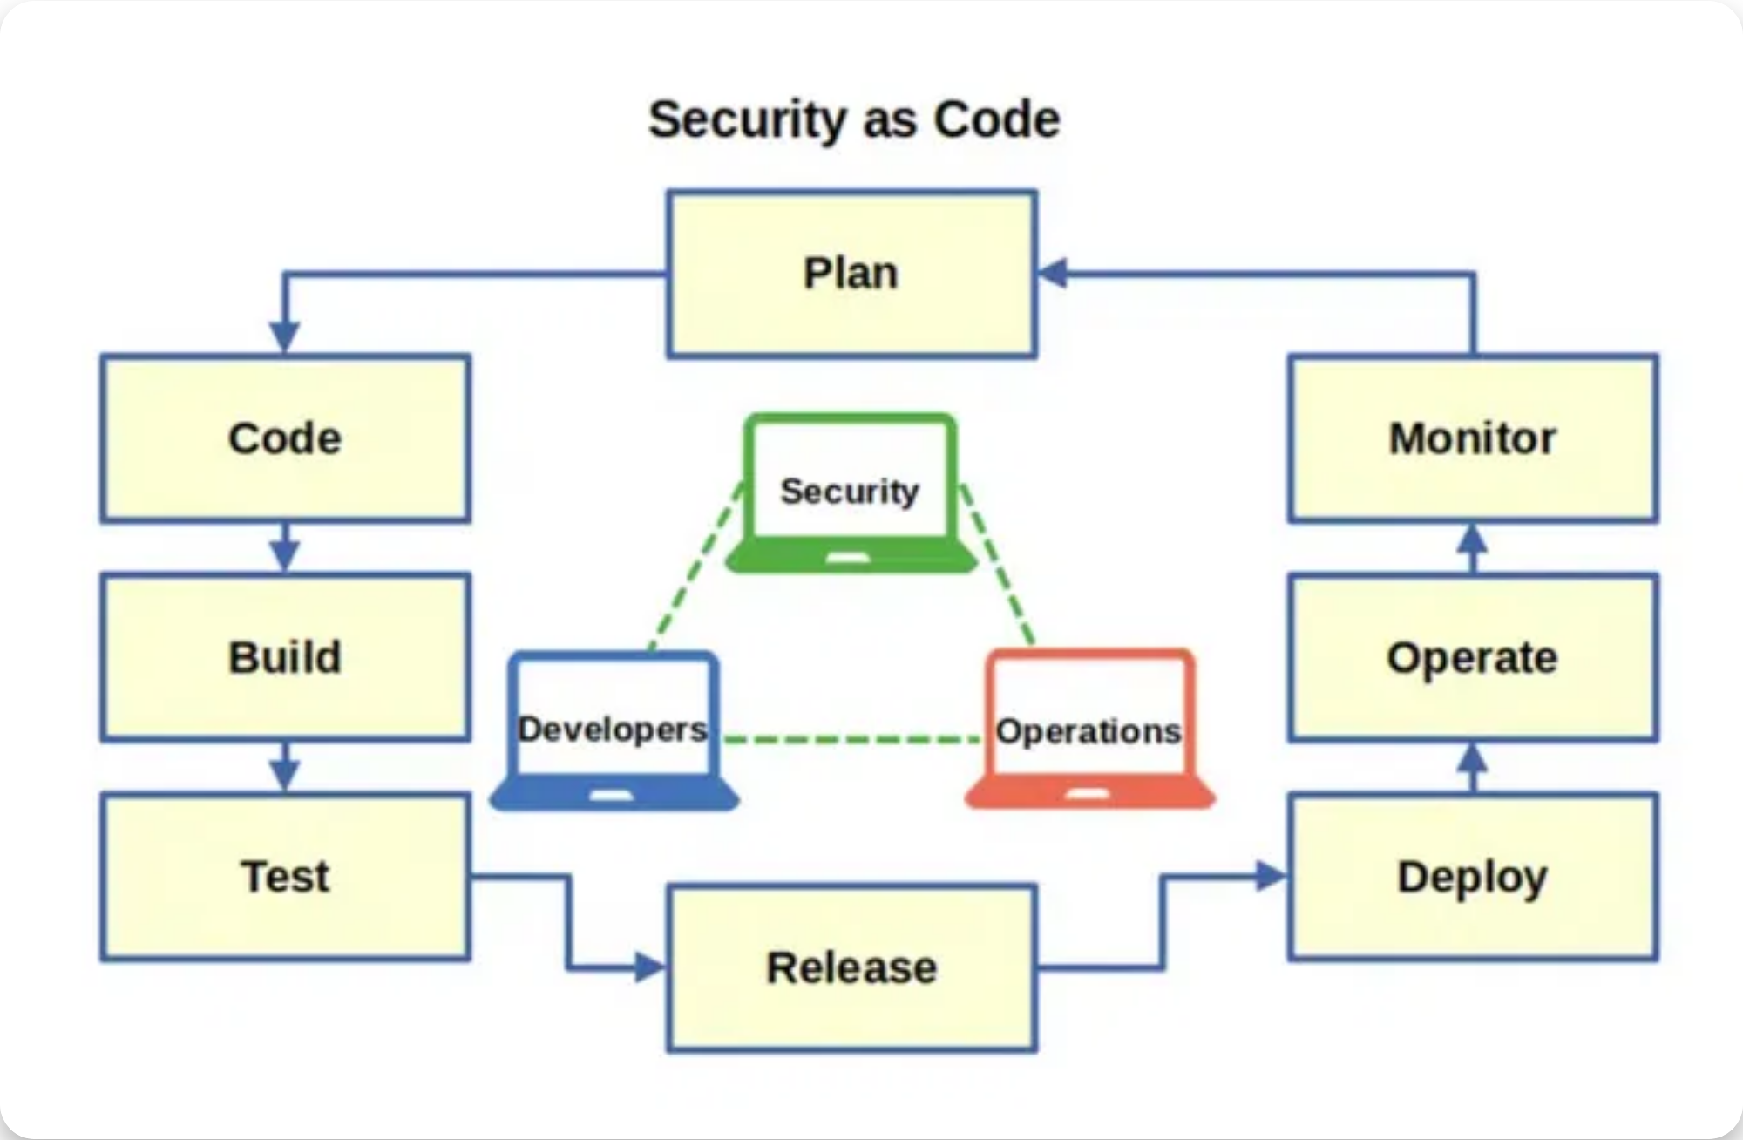


PILLARS OF SOFTWARE SECURITY
Pillar I: Risk Management
Continuous process to identify, rank, track, and understand software security risks.
Pillar II: Touchpoints
Set of best practices applied to software artifacts throughout development.
Pillar III: Knowledge
Gathering, encapsulating, and sharing security knowledge across the organization.
Dr. Mohammed Tawfik
2

Slide 3
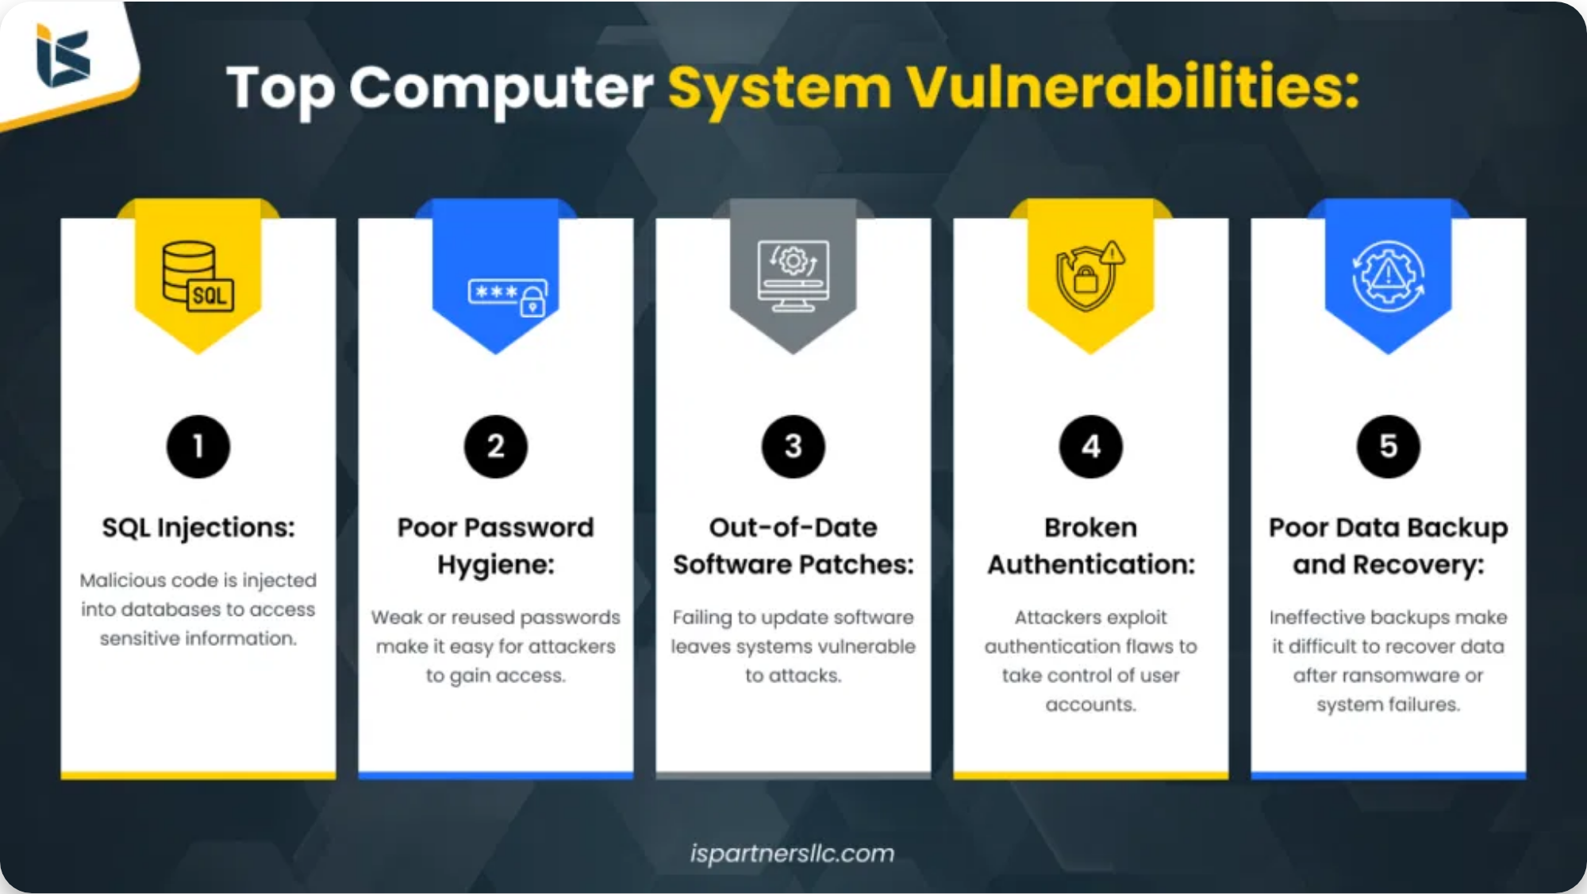





PILLAR I: RISK MANAGEMENT
What is Risk Management?
A continuous process that identifies, ranks, tracks, and understands software security risks.
RMF Activities:
Understand the business context
Identify business and technical risks
Synthesize and prioritize risks
Define mitigation strategy
Carry out fixes and validate
Dr. Mohammed Tawfik
3

Slide 4


PILLAR II: TOUCHPOINTS
What are Security Touchpoints?
Best practices applied to software artifacts throughout the development lifecycle to ensure security is built in, not bolted on.
Key Characteristics
Applied at specific points in the SDLC
Focus on different artifacts (code, design, requirements)
Combine proactive and reactive approaches
Integrate with existing development processes
Benefits
Touchpoints provide a structured approach to identify and address security issues early, reducing cost and improving overall security posture.
Dr. Mohammed Tawfik
4

Slide 5


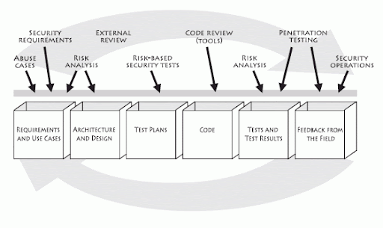


SEVEN TOUCHPOINTS (1)
Code Review
Systematic examination of source code to find and fix security vulnerabilities that automated tools might miss. Focuses on implementation bugs and security-specific issues. E.g Checkmarx CxSAST, SonarQube, Bandit
Architectural Risk Analysis
Examines software design and architecture for security flaws. Identifies threats, vulnerabilities, and appropriate countermeasures at the design level. E.g Microsoft Threat Modeling Tool , OWASP Threat Dragon
Penetration Testing
Simulates attacks from malicious outsiders to identify exploitable vulnerabilities in deployed software. Tests the system from an attacker's perspective.
Dr. Mohammed Tawfik
5

Slide 6




SEVEN TOUCHPOINTS (2)
4. Risk-Based Security Tests
5. Security Operations
Tests designed specifically to probe security risks identified during the architectural risk analysis and requirements phases.
Maintaining security during deployment and operations through proper configuration, monitoring, and incident response.
7. External Analysis
6. Abuse Cases (Security Requirements)
Independent security review by external experts who can provide an unbiased assessment of the system's security posture.
Abuse cases define how an attacker might misuse the system, essentially negative test cases for security.
Dr. Mohammed Tawfik
6

Slide 7


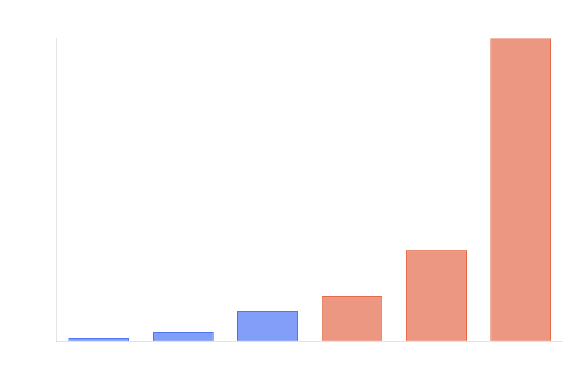



FIXING DEFECTS: EARLY IS BETTER!
The cost of fixing security defects
increases
exponentially
the later they are discovered
in the development lifecycle.
Security touchpoints help identify
vulnerabilities
early in the SDLC
when they
are less expensive to fix.
A defect found during
code review
costs 10-
30x less to fix than one found in
production
.
Implementing a
shift-left
security approach
reduces overall development costs and
improves security posture.
Dr. Mohammed Tawfik
8

Slide 8









1- CODE REVIEW
Example: Buffer Overflow
What is Security Code Review?
A systematic examination of source code to identify security vulnerabilities that automated tools might miss. It focuses on implementation bugs and security-specific issues.
// Vulnerable code
void copy_data(char *input) { char
buffer[64]; strcpy(buffer, input); // No bounds checking }
//
Fixing Secure code
void copy_data(char *input) { char buffer[64];
size_t input_len = strlen(input); if (input_len < sizeof(buffer)) {
strncpy(buffer, input, sizeof(buffer)-1);
buffer[sizeof(buffer)-1] = '\0'; } else { // Handle error condition
log_error("Input too large"); } }
Key Benefits
Identifies vulnerabilities early in the development cycle
Review Process
Identify security-critical code
Catches issues that automated tools miss
Apply security checklists and patterns
Builds security awareness among developers
Conduct manual and tool-assisted reviews
Reduces the cost of fixing security issues
Document and track findings
Dr. Mohammed Tawfik
9

Slide 9

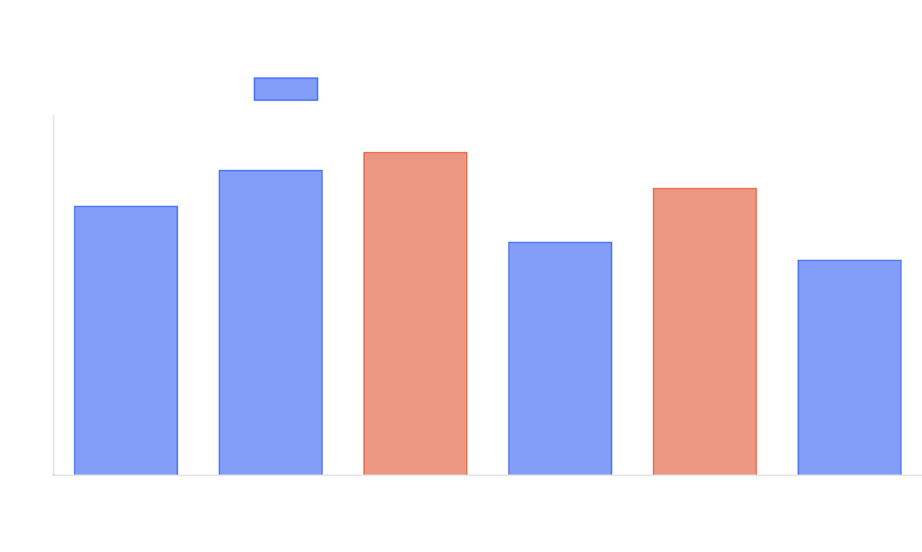
2- ARCHITECTURAL RISK ANALYSIS
What is Architectural Risk Analysis?
A systematic approach to identifying vulnerabilities and threats at the design level, before code is written. It examines how components interact and identifies security flaws in the architecture.
Process Steps:
1
Characterize the architecture (components, data flows, trust boundaries)
2
Identify attack surfaces and entry points
3
Apply threat modeling techniques (STRIDE, attack trees)
4
Determine risk severity and prioritize mitigations
Dr. Mohammed Tawfik
10

Slide 10

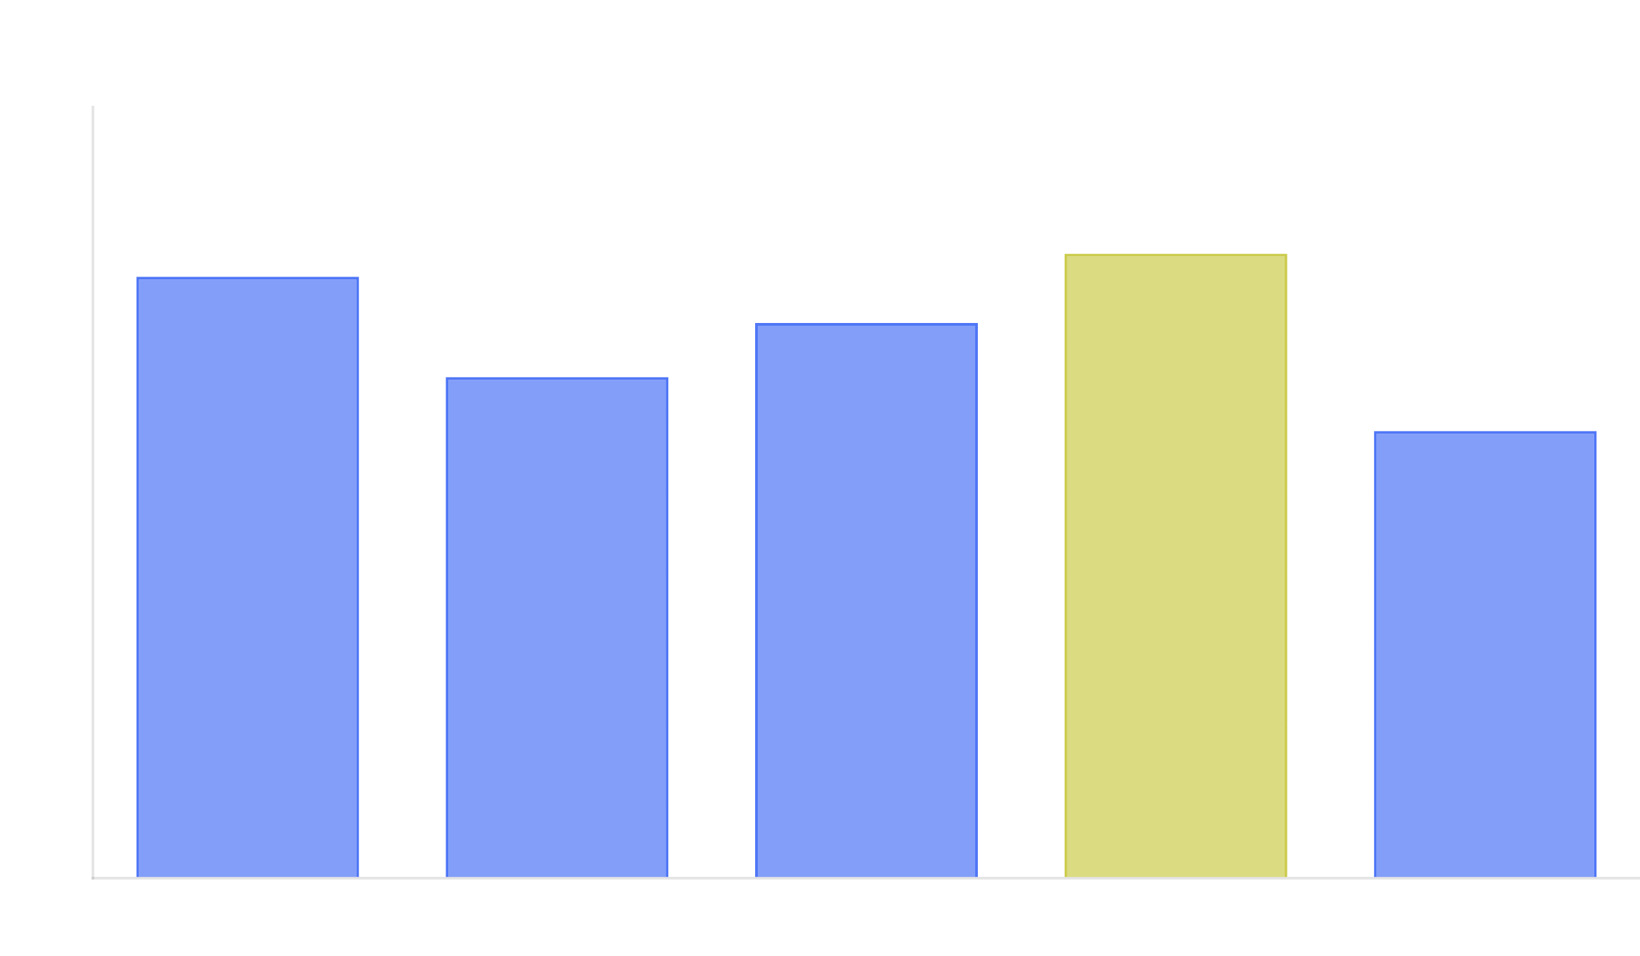





3- SOFTWARE PENETRATION TESTING
What is Penetration Testing?
A security testing methodology that simulates real-world attacks to identify exploitable vulnerabilities in a deployed system. Tests the system from an attacker's perspective.
Penetration Testing Phases:
Reconnaissance: Gather information about the target
Scanning: Identify potential vulnerabilities
Exploitation: Attempt to exploit discovered vulnerabilities
Key Benefits:
• Identifies vulnerabilities that automated tools might
Post-Exploitation: Maintain access and document findings
miss
• Validates the effectiveness of security controls
• Provides real-world attack scenarios
Reporting: Document vulnerabilities and recommend fixes
• Helps prioritize security investments based on actual
exploitability
Dr. Mohammed Tawfik
11

Slide 11


SIN 1: BUFFER OVERRUNS
A buffer overrun occurs when a program writes data
beyond the allocated memory buffer
, potentially
allowing attackers to execute arbitrary code.
Vulnerable Code
One of the
oldest and most dangerous
software
void copy_user_input(char* input) { char buffer[64]; // No
vulnerabilities
bounds checking! strcpy(buffer, input); // Process buffer... }
Common in languages like C and C++ that don't perform
Secure Code
automatic bounds checking
void copy_user_input(char* input) { char buffer[64]; // Check
Use
safe string functions
(strncpy instead of strcpy)
input length if (strlen(input) >= sizeof(buffer)) { // Handle error
condition return; } // Use safer function with size limit
Implement
proper input validation
and bounds
strncpy(buffer, input, sizeof(buffer)-1); buffer[sizeof(buffer)-1] =
checking
'\0'; // Process buffer... }
Consider
memory-safe languages
like Java, C#, or Rust
Dr. Mohammed Tawfik
12

Slide 12


SIN 2: FORMAT STRING PROBLEMS
Vulnerable Code:
Format string vulnerabilities occur when user input is
// User input directly used as format string void
used directly as the format string in functions like
log_message(char *user_input) { printf(user_input); //
printf()
,
sprintf()
, or
fprintf()
without proper
VULNERABLE! } // Attacker can input: "%x %x %x %x" // This will
validation.
print values from the stack
Secure Code:
Attackers can use format specifiers like
%s
,
%x
, or
%n
to
read or write to memory locations.
// Explicit format string with user input as argument void
log_message(char *user_input) { printf("%s", user_input); //
SAFE } // Using size-limited alternatives void
Can lead to information disclosure, denial of service, or even arbitrary code execution.
log_message_to_buffer(char *user_input, char *buffer, size_t
buffer_size) { snprintf(buffer, buffer_size, "%s", user_input); }
Always use explicit format strings
with user-supplied
data as arguments, never as the format string itself.
Impact:
// Attacker input: "%08x.%08x.%08x.%08x"
// Output:
Use
secure alternatives
like
snprintf()
with proper size
"bffff3c0.08049ee0.bffff1c4.00000001" // Reveals memory
limits.
contents
// Attacker input: "AAAA%n"
// Can write the value 4 to a
memory location // Potentially overwriting critical data
Dr. Mohammed Tawfik
13

Slide 13

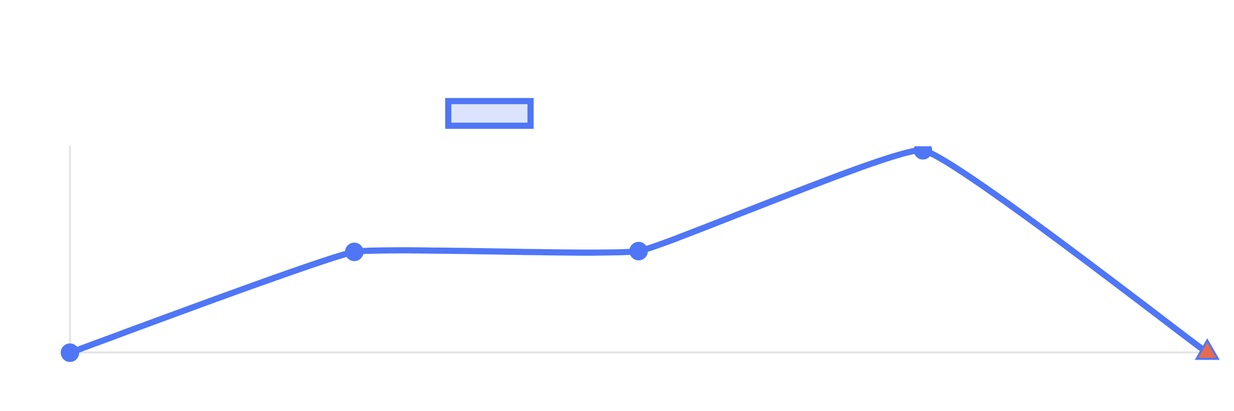


SIN 3: INTEGER OVERFLOWS
Integer overflow occurs when an arithmetic
operation attempts to create a numeric value that is
outside the range
that can be represented with a
given number of bits.
Can lead to
buffer overflows
, incorrect calculations, and
Vulnerable Code Example
security vulnerabilities.
// Integer overflow in memory allocation
void
process_data(size_t num_elements) { size_t size =
Often occurs in
memory allocation
, array indexing, and
num_elements * sizeof(int); int *buffer = (int *)malloc(size); //
If num_elements is very large, size could overflow // and
loop counters.
allocate less memory than expected // ... use buffer ...
free(buffer); }
Use
range checking
before performing arithmetic
operations.
Secure Code Example
Consider using
safe integer libraries
that detect
// Safe version with overflow check void process_data(size_t
overflows.
num_elements) { // Check for potential overflow if
(num_elements > SIZE_MAX / sizeof(int)) { // Handle error
In C/C++, use
size_t
for sizes and
intmax_t/uintmax_t
condition return; } size_t size = num_elements * sizeof(int); int
for large integers.
*buffer = (int *)malloc(size); if (buffer == NULL) { // Handle
allocation failure return; } // ... use buffer safely ... free(buffer);
}
Dr. Mohammed Tawfik
14

Slide 14

SIN 4: SQL INJECTION
// Vulnerable code String query = "SELECT * FROM users WHERE
SQL Injection occurs when untrusted user input is incorporated into SQL queries without proper validation or sanitization, allowing attackers to manipulate database queries.
username='" + username + "' AND password='" + password + "'";
Statement stmt = connection.createStatement(); ResultSet rs =
stmt.executeQuery(query);
// Attack input: username = admin' --
//
Resulting query:
// SELECT * FROM users WHERE username='admin' --'
AND password=''
// The -- makes the rest a comment, bypassing
Can lead to
password check
// Secure code using prepared statement String
modification, or complete database compromise
unauthorized data access
, data
query = "SELECT * FROM users WHERE username = ? AND
password = ?"; PreparedStatement pstmt =
Attackers can bypass authentication, extract sensitive
connection.prepareStatement(query); pstmt.setString(1,
data, or execute
administrative operations
username); pstmt.setString(2, password); ResultSet rs =
pstmt.executeQuery();
Use
parameterized queries
or prepared statements
Common attack vectors:
Login forms, search fields, URL
Apply
input validation
and use ORM frameworks
parameters, and any input that affects SQL queries
Implement
least privilege
database accounts
Attack techniques:
Union-based, error-based, blind,
time-based, and out-of-band injection
Dr. Mohammed Tawfik
15

Slide 15

SIN 5: COMMAND INJECTION
Command injection occurs when an application passes unsafe user-supplied data to a system shell. Attackers can execute arbitrary commands on the host operating system.
Vulnerable PHP Code
Command injection vulnerabilities are
particularly
// Vulnerable code $ip = $_GET['ip']; system("ping -c 4 " . $ip); //
dangerous
as they can lead to complete system
Attacker input: 127.0.0.1; rm -rf / // This would execute: ping -c
compromise.
4 127.0.0.1; rm -rf /
Common in applications that use system commands to process user input, like file uploads, network tools, or admin interfaces.
Secure PHP Code
// Secure approach 1: Input validation $ip = $_GET['ip']; if
(!preg_match('/^\d{1,3}\.\d{1,3}\.\d{1,3}\.\d{1,3}$/', $ip)) {
Never
directly incorporate user input into command
die("Invalid IP address"); } system("ping -c 4 " . $ip); // Secure
strings.
approach 2: Use built-in functions $ip = $_GET['ip']; if
(filter_var($ip, FILTER_VALIDATE_IP)) { exec("ping -c 4 " .
Use
parameterized APIs
and avoid shell execution when
escapeshellarg($ip), $output); echo implode("\n", $output); }
possible.
Implement
strict input validation
and use allowlists for
permitted characters.
Dr. Mohammed Tawfik
17

Slide 16

SIN 6: FAILING TO HANDLE ERRORS
Poor error handling can expose sensitive information, leave systems in inconsistent states, or create security vulnerabilities that attackers can exploit.
Vulnerable Java Code
try { // Database operation Statement stmt =
conn.createStatement(); ResultSet rs =
stmt.executeQuery(query); // Process results... } catch
Verbose error messages
can reveal implementation
(SQLException e) { // Reveals implementation details to users
details, database structures, or file paths.
response.getWriter().println( "Database error: " +
e.getMessage()); e.printStackTrace(); }
Uncaught exceptions
can lead to application crashes or
denial of service.
Secure Java Code
try { // Database operation Statement stmt =
Use
structured exception handling
to catch and handle
conn.createStatement(); ResultSet rs =
all errors appropriately.
stmt.executeQuery(query); // Process results... } catch
(SQLException e) { // Log detailed error for developers
Display
generic error messages
to users while logging
logger.error("Database error: " + e.getMessage(), e); // Return
detailed information securely.
generic message to user response.getWriter().println( "An error
occurred. Please try again later."); // Notify administrators if
Implement
graceful degradation
to maintain
critical if (isCriticalOperation()) { alertAdministrators(e); } }
functionality during errors.
Dr. Mohammed Tawfik
18

Slide 17


SIN 7: CROSS-SITE SCRIPTING (XSS)
Vulnerable Code
Cross-Site Scripting occurs when an application includes untrusted data in a web page without proper validation, allowing attackers to execute malicious scripts in users' browsers.
// Reflected XSS String searchTerm = request.getParameter("q");
out.println("Search results for: " + searchTerm); // Stored XSS String
comment = request.getParameter("comment");
database.store(comment); // Later displayed without escaping
out.println(comment);
Reflected XSS
Secure Code
Malicious script is reflected off a web server, typically delivered via URLs.
// Using proper output encoding String searchTerm =
Stored XSS
request.getParameter("q"); out.println("Search results for: " +
HtmlUtils.htmlEscape(searchTerm)); // Content Security Policy header
Malicious script is stored on the target server and later displayed to users.
response.setHeader("Content-Security-Policy", "default-src 'self'; script-
src 'self'");
DOM-based XSS
Vulnerability exists in client-side code that modifies the DOM environment.
Always
encode output
based on the context
Implement
Content Security Policy
(CSP)
Dr. Mohammed Tawfik
19

Slide 18



SIN 8: FAILING TO PROTECT NETWORK TRAFFIC
Unprotected network traffic can be intercepted, allowing attackers to steal sensitive information, hijack sessions, or perform man-in-the-middle attacks.
Unencrypted HTTP transmits data in
plaintext
, making it
vulnerable to eavesdropping
Sensitive data like
credentials, personal information,
and session tokens
can be captured
Use
HTTPS
with TLS 1.2+ for all web applications
Implement
HTTP Strict Transport Security
(HSTS) to
prevent downgrade attacks
Use
secure cookies
with HttpOnly and Secure flags
Dr. Mohammed Tawfik
20

Slide 19

SIN 9: MAGIC URLS AND HIDDEN FORMS
Vulnerable Magic URL
Magic URLs and hidden form fields are often used to maintain state in web applications, but they can expose sensitive information or allow attackers to manipulate application behavior.
// Magic URL with sensitive information
https://example.com/account?user_id=1234&role=user //
Attacker modifies URL https://example.com/account?
user_id=1234&role=admin
Vulnerable Hidden Form Field
Magic URLs
contain sensitive data or authentication
<form action="/purchase" method="post"> <input
tokens in the URL, which can be leaked through browser
type="hidden" name="price" value="19.99"> <input
history, referrer headers, or bookmarks
type="submit" value="Buy Now"> </form> // Attacker can
modify the price value using browser tools // before submitting
Hidden form fields
can be easily viewed and modified
the form
using browser developer tools
Secure Approach
Use
server-side session management
instead of client-
side state
// Server-side session management
session.setAttribute("user_role", "user"); // Server-side
Implement
anti-CSRF tokens
for all forms
validation public void processPurchase(HttpServletRequest
request) { String productId =
Always
validate all data
on the server side, regardless of
request.getParameter("product_id"); // Look up the real price
source
from the database BigDecimal price =
productService.getPrice(productId); // Process the purchase
with the server-side price }
Dr. Mohammed Tawfik
21

Slide 20

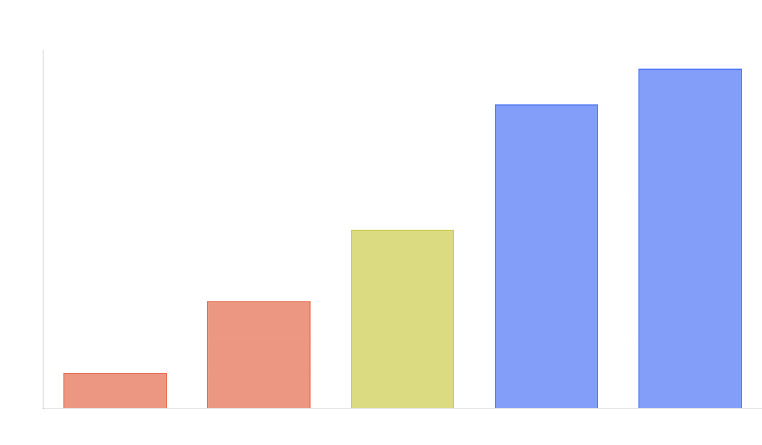
SIN 10: IMPROPER USE OF SSL/TLS
Even when SSL/TLS is implemented, improper configuration or implementation can lead to vulnerabilities that compromise the security of encrypted communications.
Using
outdated protocols
like SSL 2.0/3.0 or TLS 1.0/1.1
with known vulnerabilities
Supporting
weak cipher suites
that can be broken
through cryptanalysis
Improper
certificate validation
allowing man-in-the-
middle attacks
Use
TLS 1.2 or higher
with strong cipher suites
Implement
proper certificate validation
and pinning
Configure
secure TLS settings
using industry best
practices
Dr. Mohammed Tawfik
22

Slide 21

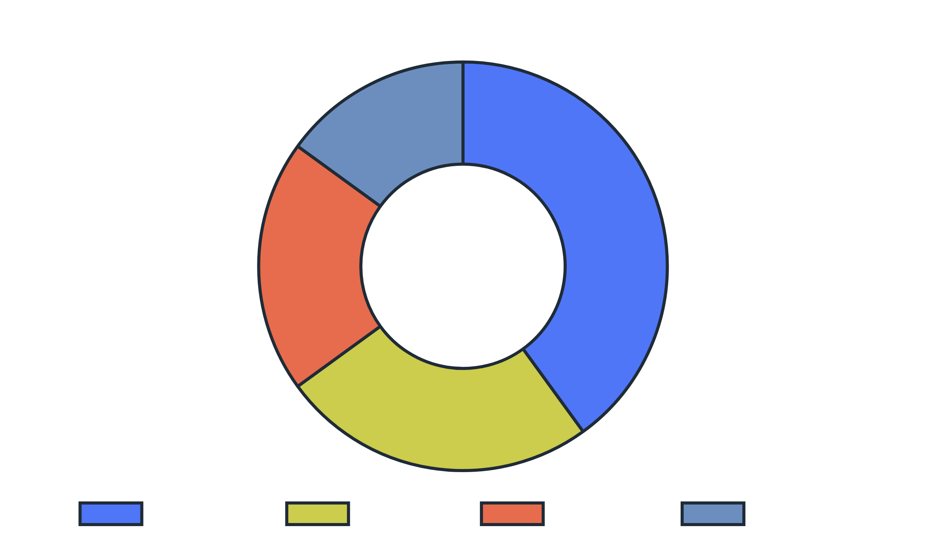






SOFTWARE SECURITY BEST PRACTICES
Adopt a
security-first mindset
throughout the entire
software development lifecycle
Implement
secure coding standards
and conduct
regular code reviews focused on security
Use
automated security testing tools
(SAST, DAST, SCA)
integrated into your CI/CD pipeline
Apply the principle of
least privilege
to all system
Provide regular
security training
for all development
components and user accounts
team members
Implement
defense in depth
with multiple layers of
Keep all
address known vulnerabilities
dependencies and libraries updated
to
security controls
Maintain comprehensive
security documentation
and
incident response plans
Dr. Mohammed Tawfik
23

Slide 22




Software security is not a feature but a
continuous process
that
must be integrated throughout the entire software development
lifecycle.
Risk Management
Touchpoints
Knowledge
Identify, prioritize, and mitigate security risks throughout development
Apply security best practices at key points in the SDLC
Build security expertise and awareness across the organization
Security is a process, not a product. It's about building systems that remain secure despite inevitable vulnerabilities and attacks.
Dr. Mohammed Tawfik
24

